Slide 1
Parallelization of longest common subsequence problem
Group 14
108062313 黃允暘 108062318 張硯博

Slide 2
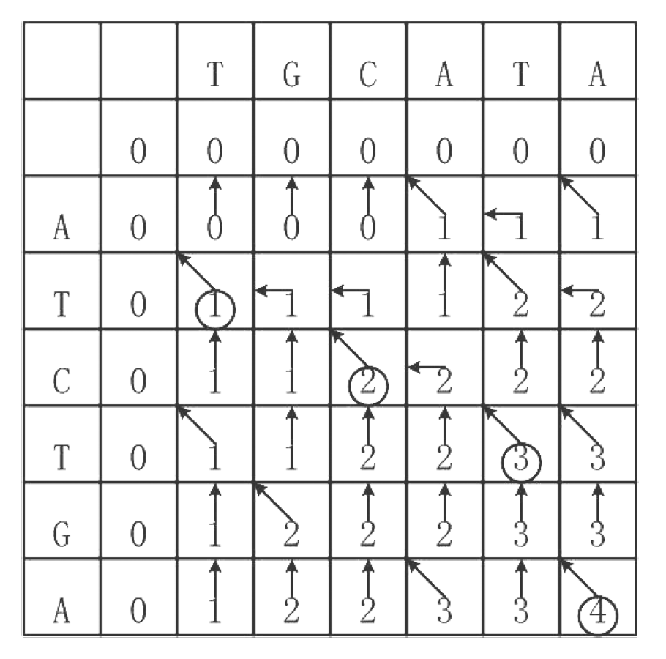
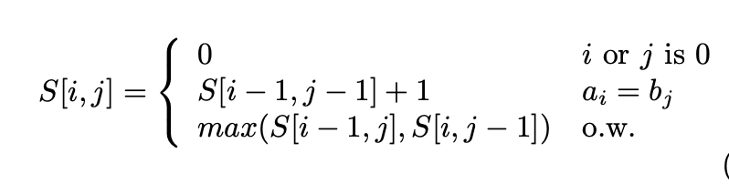
Regular dp solution

Slide 3
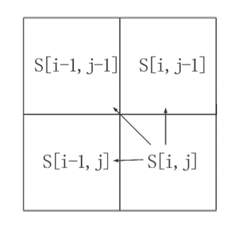
Regular dp solution

Slide 4
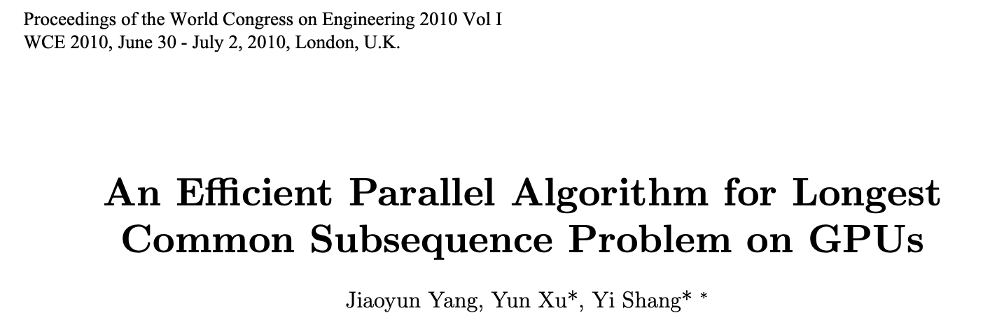

Slide 5
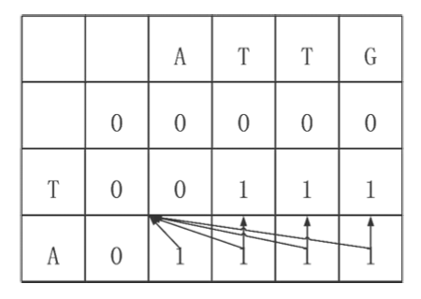
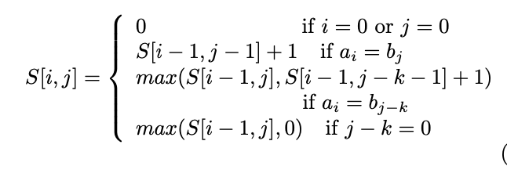
Revised for parallel

Slide 6
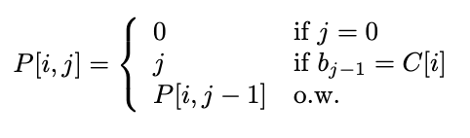
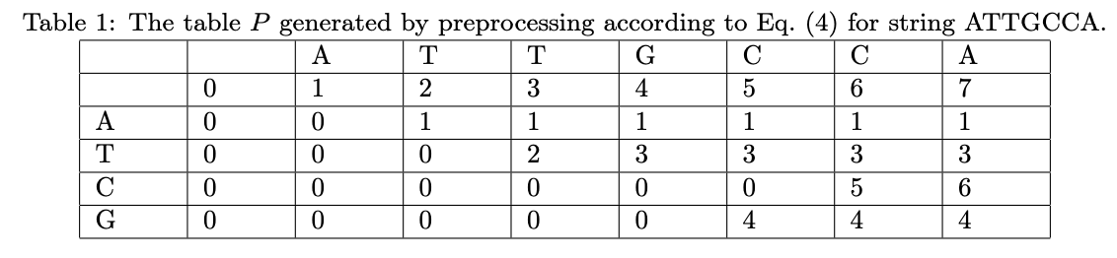
P table

Slide 7
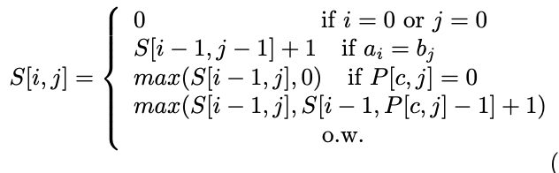
Revised for parallel

Slide 8
MPI

Slide 9


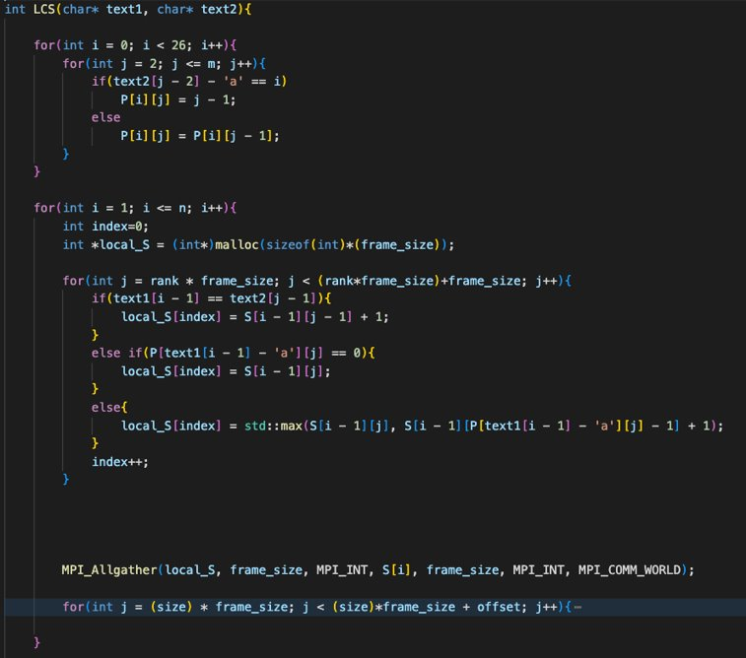

Implementation
Every node is responsible for certain parts of table S.
After calculation, use MPI_Allgather to synchronize every node.

Slide 10
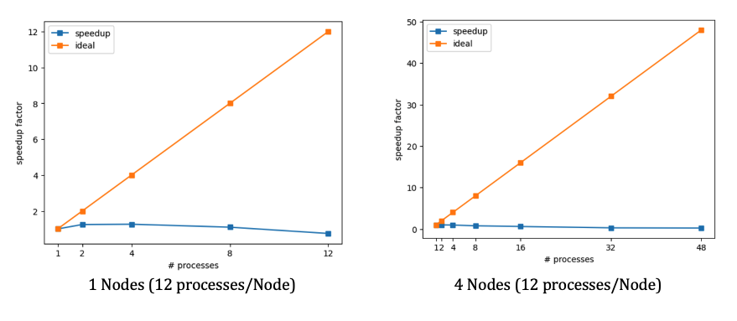
Speedup factor

Slide 11
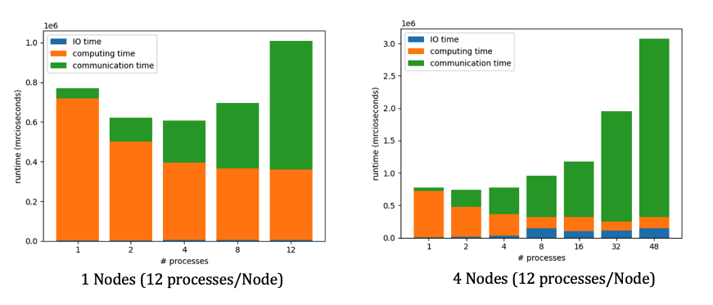
Time Profile

Slide 12
OpenMP

Slide 13
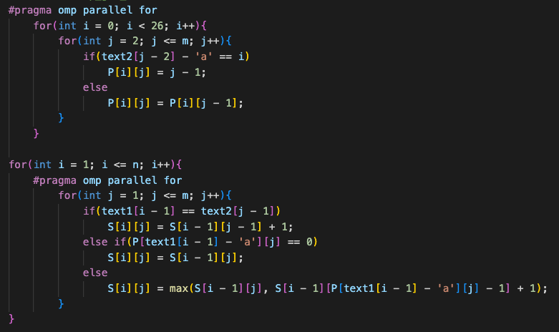
Implementation
Use static method to parallelize for loop.

Slide 14
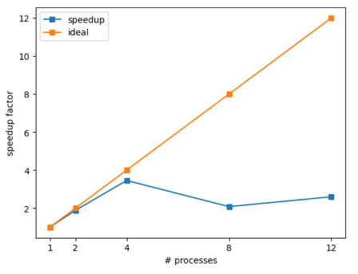
Speedup factor
1 Nodes (12 processes/Node)

Slide 15
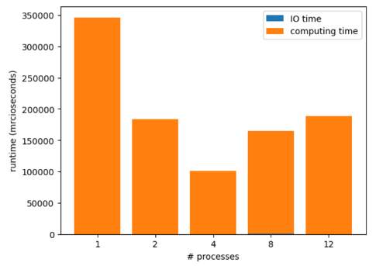
Time Profile
1 Nodes (12 processes/Node)

Slide 16
GPU

Slide 17
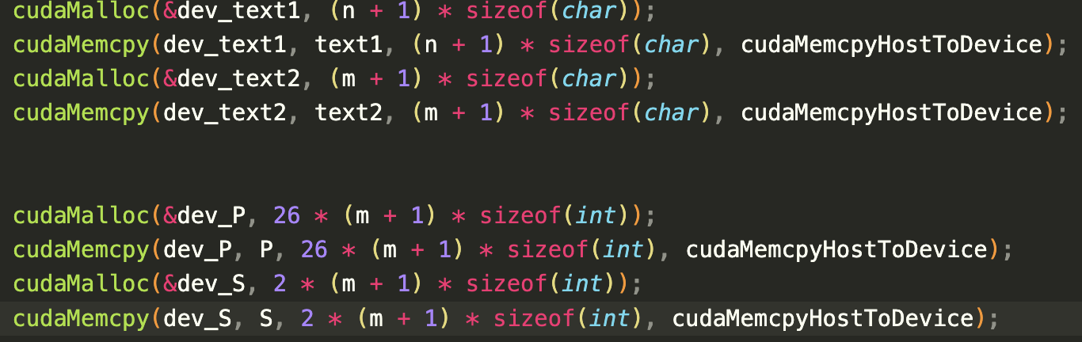
Implementation

Slide 18
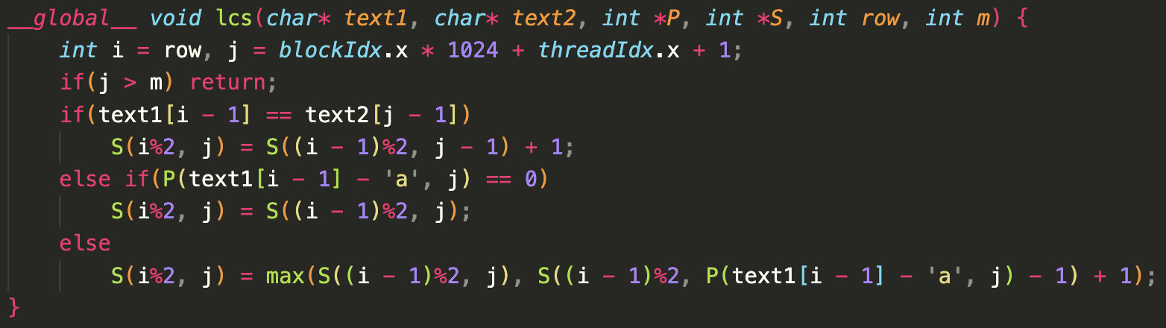
Implementation

Slide 19
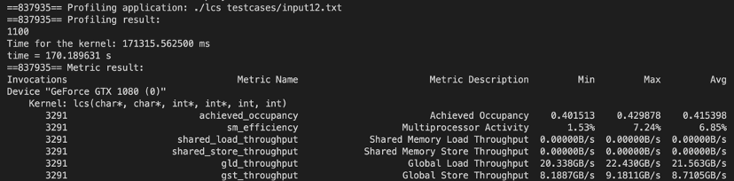
Profiling Result

Slide 20
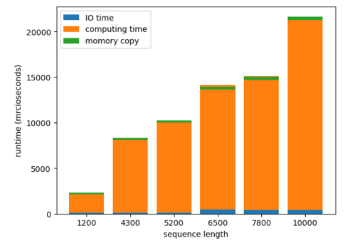
Time distribution

Slide 21
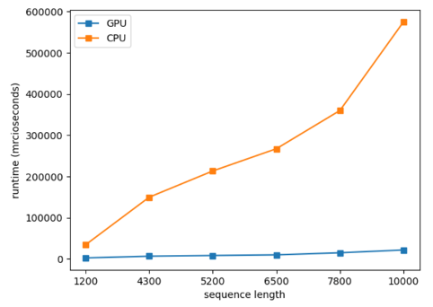
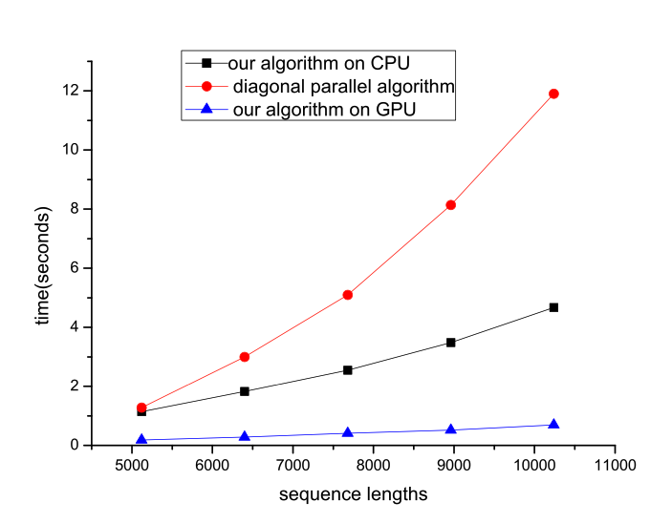
CPU v.s. GPU

Slide 22
Individual contribution
黃允暘：MPI version、doing experiments
張硯博：openMP version、GPU version

Slide 23
Thank you for your listening

